Slide 1
Fundamentals of Data Representation
Sound

Slide 2
Objectives
Be able to:
Understand what sound is in its natural form and how it is processed in a way that can be stored on a computer.
Show that the quality of sound is affected by two key factors when capturing it.
Calculate the file sizes of captured sound.

Slide 3
How do we represent sounds on a computer?
Sound is all around us.
People started being able to capture sound for the purposes of replaying it about 150 years ago.
It is only relatively recently that we have seen the use of digital recording techniques.
Notes:
Quiz 1 is available in the accompanying ‘Lesson plan and printable activities’ Word document.

Slide 4
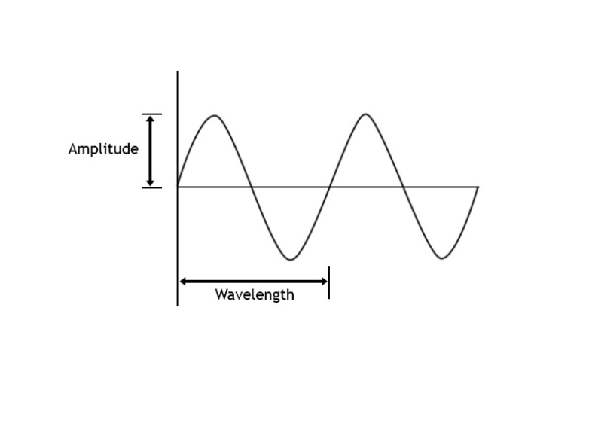
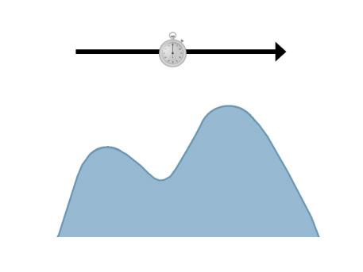
What is analogue sound?
Key point
In its natural form, sound occurs in an analogue format and has a continuous (unbroken) form which has infinite definition.
Naturally occurring sounds are analogue, generated as a continuous waveform over time:
Basic analogue wave
Analogue wave showing positive and negative amplitude
Analogue waves are continuous, i.e. have no break. They have infinite resolution.
Sound can have positive and negative amplitude and it is usual to see it represented using the continuous sine wave format.

Slide 5
Capturing analogue sound – the digitisation of sound
To store sound we must convert it into a digital format that a computer can play.
Note:
there are limits to the quality of sound that may be captured
sound files can be very large if storing in high quality
CD quality files are too big for downloading
MP3 files are only suitable for playback devices not storage.
In order for sound to be captured it must be sampled digitally by ‘slicing up’ the sound horizontally (by amplitude) and vertically (by time duration) and capturing a digital snapshot.
The quality of the sound produced depends on how many samples are taken and the resolution of the sampling.
Notes:
For more information, see page 2 of ‘3.3.2 Teacher notes’.

Slide 6
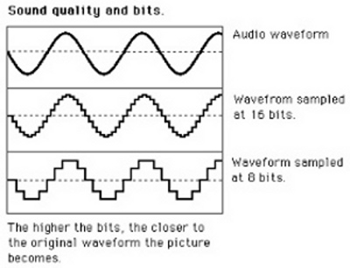
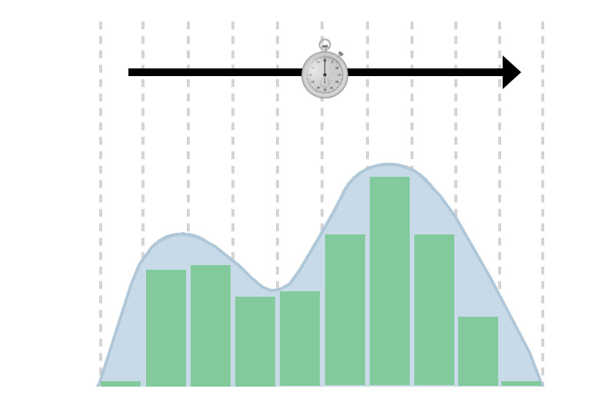
Sampling rate is measured by taking vertical slices of the sound:
To capture a sound at CD quality, we would need to take 44,100 samples every second! We would ‘draw’ 44,100 (vertical) lines in one second to divide it up.
We would say that a sampling frequency of 44.1 kHz was used.

Slide 7
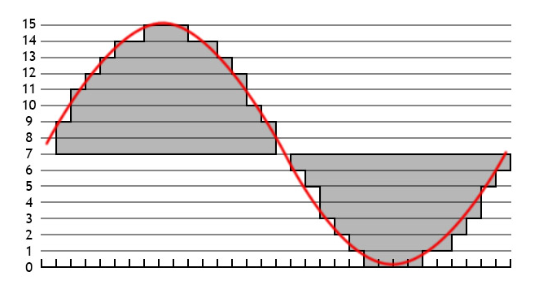
Amplitude (sample resolution) is measured by taking horizontal slices of the sound:
As you can see here, it is divided into 16 slices and it is not that accurate.

Slide 8
The resolution of the capture is determined by how many slices we take across the wave – we have got 16 here.
2⁴ = 16 therefore 4 bits are enough to represent every possible level of this diagram.
Decimal value | Binary | Decimal value | Binary | Decimal value | Binary | Decimal value | Binary
0 | 0000 | 4 | 0100 | 8 | 1000 | 12 | 1100
1 | 0001 | 5 | 0101 | 9 | 1001 | 13 | 1101
2 | 0010 | 6 | 0110 | 10 | 1010 | 14 | 1110
3 | 0011 | 7 | 0111 | 11 | 1011 | 15 | 1111
If we use the CD as an example again, we would actually use a 16-bit sampling code, this would give not 16 possible levels but 65,536!
Key point
Digital sound is represented as discrete (single addressable) points captured by ‘mapping out’ an analogue sound wave – a binary value representing each point is stored in a recognised file format and reproduced by the digital media player used e.g. Windows Media Player.

Slide 9
Determining the size of sound files
How do amplitude and frequency fit together to determine the overall size of captured sound files?
File size (bits) = Sampling rate (Hz) × Resolution (bits) × Sample length (seconds)
Example: Recording a song by an artist in stereo, the song lasts four minutes and the sound is CD quality.
Sampling rate: | 44,100 | Resolution: | 16 bits
Length of sample: | 4 × 60 = 240 | File size = 44,100 × 240 × 16 = 169,344,000 (bits)*
* Much larger than a conventional MP3 file.

Slide 11
Question 2
The same sound engineer needs to record a small group of musicians performing a jingle for an advert – the jingle will last for 10 seconds. She calculates that it will need four microphones (ie four channels of sound needed) to do this and for a good quality of sound, she needs to use 16-bit sampling at a 5000 Hz frequency.
How big will the sound file be in bytes?
How big in kilobytes?

Slide 12
Question 3
Another sound engineer pulls out an old recording that has a size of 2.2 MB. The label on the box says that it was recorded in mono (one channel), that it had a recording sampling frequency of 20 kHz and used 8-bit sampling.
How long would this piece of music last?
Rearrange formula first.

Slide 13
Question 4
In order to get highest quality on a sound clip for a file for downloading, a decision is made to take up to 256 samples of amplitude. The clip is to be 60 seconds long and it has been stipulated that the file should not exceed 240,000 bytes in size.
What is the maximum possible sampling frequency that can be used?
Rearrange formula with conversion of 256 levels to 1 byte encoding (= 28).

Slide 14
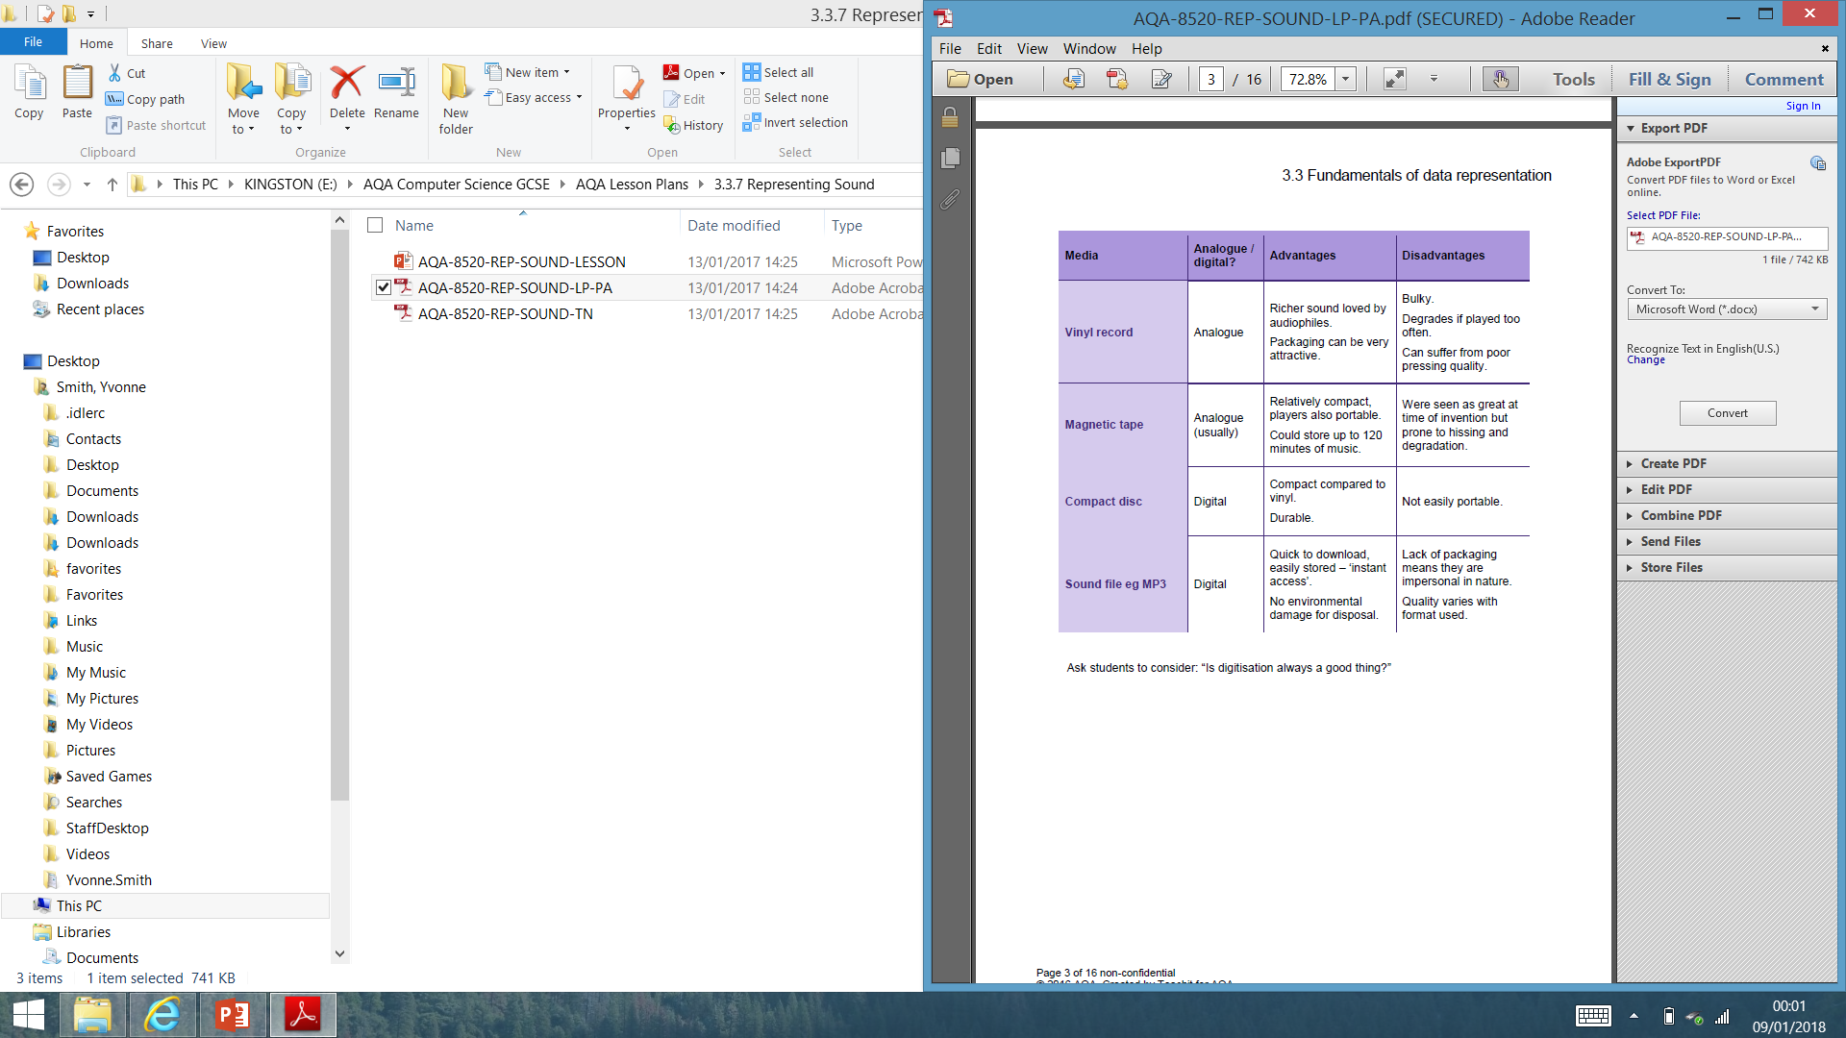
Is digitisation always a good thing?

